Slide 1
Two-Dimensional Arrays and Nested Loops – part 5
Barb Ericson
Georgia Institute of Technology
August 2005

Slide 2
Learning Goals
Understand at a conceptual and practical level
  How to copy one picture to another so that the first picture is rotated 90 degrees left or right
  How to simplify a problem
  How to come up with an algorithm to solve a problem
  How to test the algorithm

Slide 3
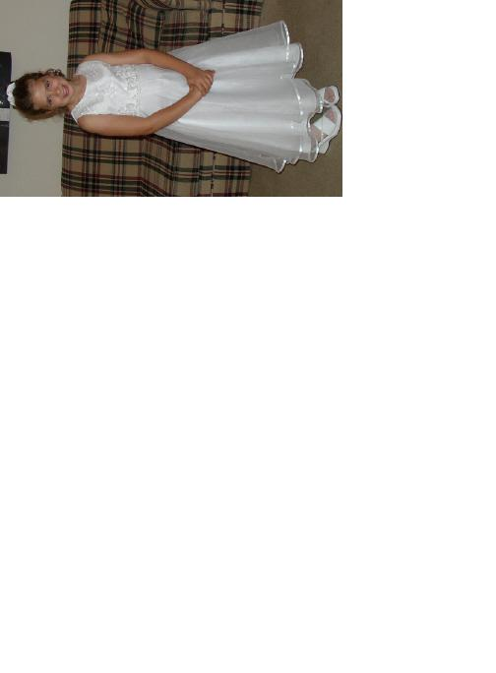
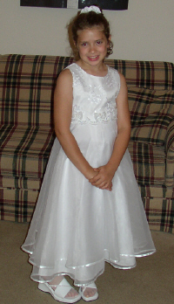
Left Rotation
How can you copy one picture onto another so that the first picture is rotated to the left 90 degrees?

Slide 4
Left Rotation
First simplify the problem by thinking about how to copy when each pixel has a number at it
Can you come up with an algorithm for this?
0
1
2
1 | 2 | 3
4 | 5 | 6
0
1
0
1
3 | 6
2 | 5
1 | 4
0
1
2

Slide 5
Left Rotation
Try out your algorithm on another example
  Does it work?
Can you translate it into code?
0
1
2
3
5 | 6 | 7 | 8
1 | 2 | 3 | 4
0
1
0
1
0
1
2
3

Slide 6
Left Rotation
To rotate an image left 90 degrees still copy all the pixels
  But they go to different locations in the target
    Column values become row values
    target x = source y
    target y = source width -1 – source x
0
1
2
1 | 2 | 3
4 | 5 | 6
0
1
0
1
3 | 6
2 | 5
1 | 4
0
1
2

Slide 7
Left Rotation Algorithm
Create the target picture object
Invoke the method on the target picture
  Create the source picture object
  Loop through the source x
    Loop through the source y
      Get the source pixel at the x and y values
      Get the target pixel with the x equal the source y value and the y equal the source picture width – 1 minus the source x
      Copy the color from the source pixel to the target pixel

Slide 8
Left Rotation Method
public void copyKatieLeftRotation()
{
String sourceFile =
FileChooser.getMediaPath("KatieFancy.jpg");
Picture sourcePicture = new Picture(sourceFile);
Pixel sourcePixel = null;
Pixel targetPixel = null;
int targetX, targetY = 0;
// loop through the columns
for (int sourceX = 0;
sourceX < sourcePicture.getWidth();
sourceX++)
{

Slide 9
Copy Katie Left Rotation
// loop through the rows
for (int sourceY = 0;
sourceY < sourcePicture.getHeight();
sourceY++)
{
// set the target pixel color to the source pixel color
sourcePixel =
sourcePicture.getPixel(sourceX,sourceY);
targetX = sourceY;
targetY = sourcePicture.getWidth() – 1 – sourceX;
targetPixel = this.getPixel(targetX,targetY);
targetPixel.setColor(sourcePixel.getColor());
}
}
}

Slide 10
Testing Left Rotation
String file = FileChooser.getMediaPath(
“7inX95in.jpg”);
Picture p = new Picture(file);
p.show();
p.copyKatieLeftRotation();
p.repaint();

Slide 11
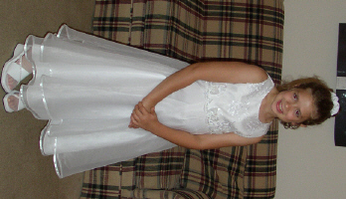
Right Rotation
How can you copy one picture onto another so that the first picture is rotated to the right 90 degrees?

Slide 12
Right Rotation
Assume that each pixel holds one number
This is the result of a right rotation on this 2-d array
Can you create an algorithm for this?
0
1
2
1 | 2 | 3
4 | 5 | 6
0
1
0
1
4 | 1
5 | 2
6 | 3
0
1
2

Slide 13
Right Rotation
Try out your algorithm on another example
  Does it work?
Can you translate it into code?
0
1
2
3
5 | 6 | 7 | 8
1 | 2 | 3 | 4
0
1
0
1
0
1
2
3

Slide 14
Right Rotation
To rotate an image right 90 degrees still copy all the pixels
  But they go to different locations in the target
    Column values become row values
    target y = source x
    target x = source height – 1 – source y
0
1
2
1 | 2 | 3
4 | 5 | 6
0
1
0
1
4 | 1
5 | 2
6 | 3
0
1
2

Slide 15
Right Rotation Exercise
Write the method to rotate the picture of Katie to the right instead of to the left
Try out the method
  String file = FileChooser.getMediaPath(“7inX95in.jpg”);
  Picture p = new Picture(file);
  p.show();
  p.copyKatieRIghtRotation();
  p.repaint();
Can you make the method more general?
  To work on any picture?

Slide 16
Summary
To copy one picture to another with the first picture rotated
  You need to change the targetX and targetY
You should simplify a problem
  And try to solve it by hand
  Then come up with an algorithm for solving it
  And then try it on another example

